Slide 1

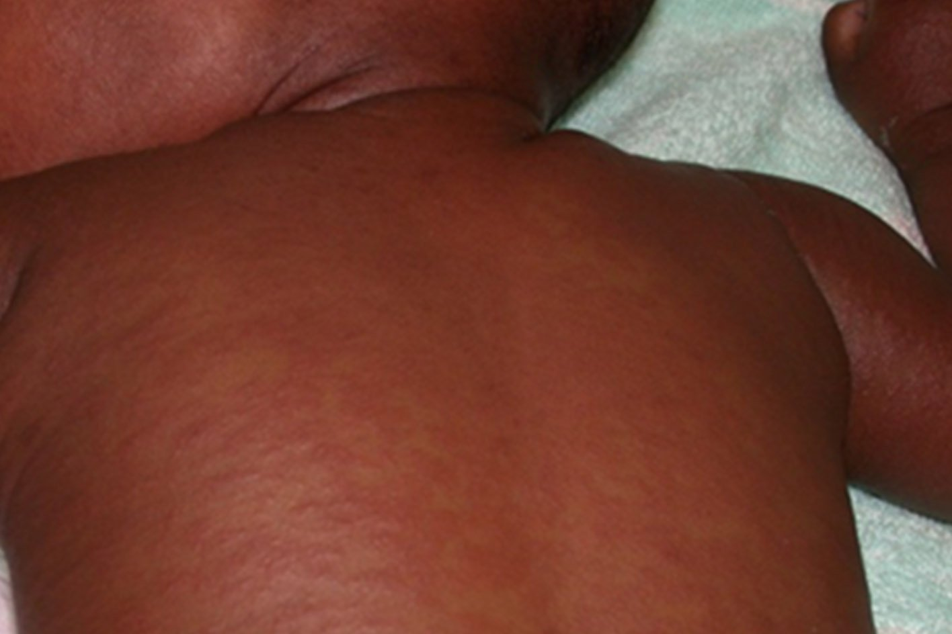
Message of the Moment
Measles cases are on the rise …………. so Think Measles!
Symptoms
Coryza (runny/stuffy nose), Cough, Conjunctivitis
High temp
Rash, usually red and blotchy that starts on the face and behind the ears, before spreading to the rest of the body (this may look different on brown and black skin)
Isolate suspected cases immediately – never leave to wait in waiting room
Level 2 PPE - FFP3 for suspected/confirmed measles cases
Test for measles – inpatient throat PCR, outpatient oral fluid test kits available from Health Protection Team (03000 030 032)
blood test for serology for IgG/IgM levels
Inform local infection prevention team, IPT on call out of hours, microbiology and Public Health Wales (AWARE) via telephone
Once discharged the room must be left vacant for 2 hours prior to a deep clean
Know your vaccination status – check through Occupational Health
All measles related guidance can be found on IP Pages of Betisnet or via the link below:
Measles
IPT 14/07/2025 v 1.0

